Slide 1
MOODIFY™
Team 08
Notes:
Recap:
A multi functional lamp
-color mode -to suit the mood
-music mode -for party and to vibe to the music
-and alarm mode (based on light) -for when your mood tells you to not wake up

Slide 2
TABLE OF CONTENTS
001
002
003
004
005
006
Product Progress
Programming (J)
Demo (J)
Testing (P)
Gitlab (P)
Future Plans
007
Communication
008
Q&A
Notes:
What we will discuss today

Slide 3
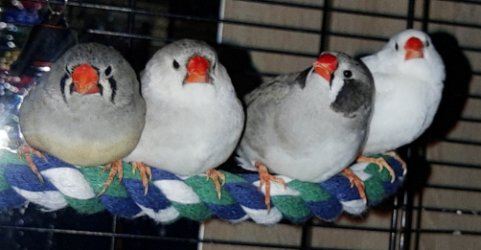
Product Progress
++
Music
Compatibility check
Web-interface
Notes:
Explain what we did this sprint.

Slide 4

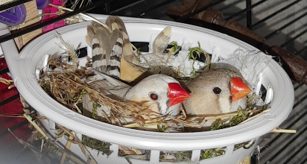
Programming
Frequency -> colour
Sound analysis
Butter-band filter

Slide 5

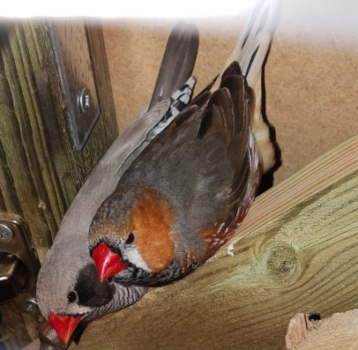
DEMO
Notes:
[IF WE DO HAVE IT]

Slide 6

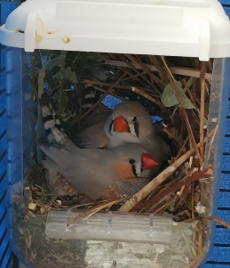
Testing
Notes:
[IF WE DO HAVE IT]

Slide 7
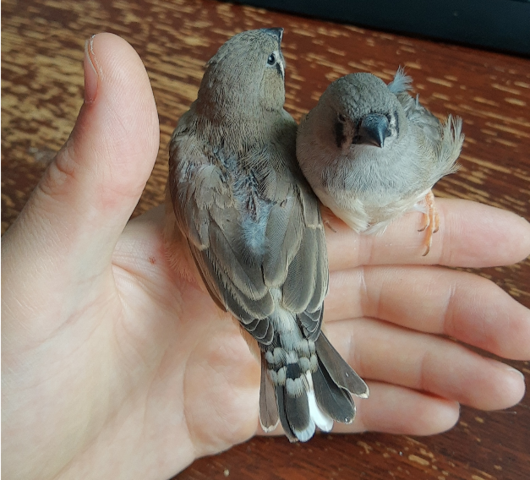
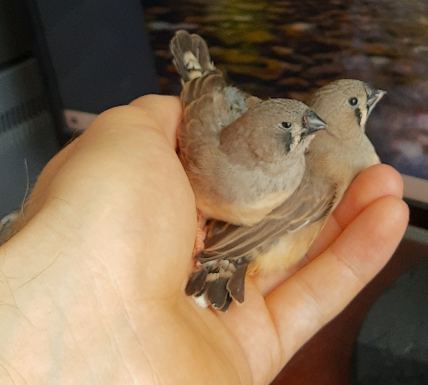
GITLAB
Notes:
Let’s go gitlab.
We will add the issues in the sprint planning meeting for the programming part.

Slide 8
FUTURE PLANS...
Sprint 5
Listen to feedback
Get a proper switch
Make necessary tweaks and adjustments
Add documentation to the code

Slide 9
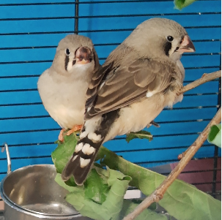
Communication
Within Team
With TAs
Discord
WhatsApp
Google Drive
Face-to-face meetings
Zulip
Jitsi
Microsoft Teams

Slide 10

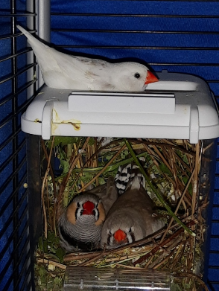
THANKS!
Do you have any questions?
If nobody has a question, then we have a question for you: How many birds in total did you see in this presentation?

